Slide 1



AtliQ Mart
Ad-Hoc Request

Slide 2


About business
Atliq Mart is a retail giant with over 50 supermarkets in the ten southern region of India. All the stores ran a massive promotions during Diwali 2023 and Sankranti 2024 on their Atliq branded products.

Slide 3

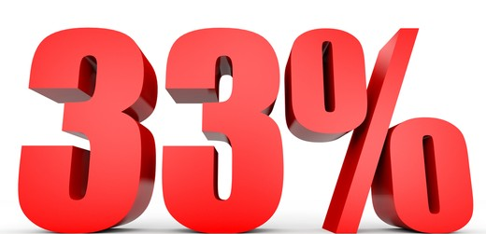


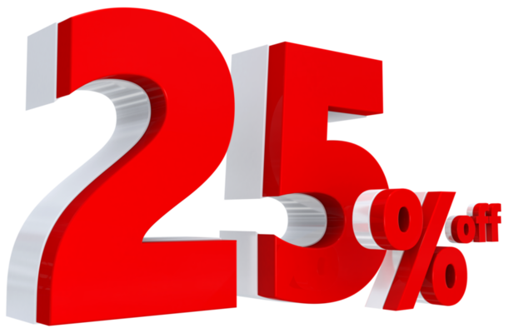

Problem
The Sales Director wants to understand which promotions did well and which did not so that they can make informed decisions for their next promotional period.
To Do: Process data using the MySQL database, run & analyze ad-hoc requests from the Sales Director, and deliver actionable insights to stakeholders.

Slide 4


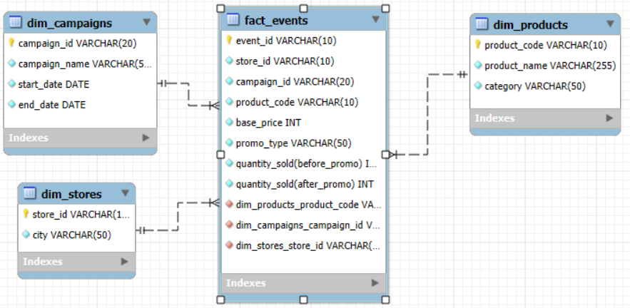
APPROACH
The dimension tables contain details related to promotion campaigns, store information, and Atliq product attributes.
Fact table captures transaction details with respective to quantity sold (before & after promotional period), base price and offer types
An entity-relationship diagram (ERD) has been created to define the relationships between the fact table and the dimension tables
Notes:
4

Slide 5

Business Requests

Slide 6
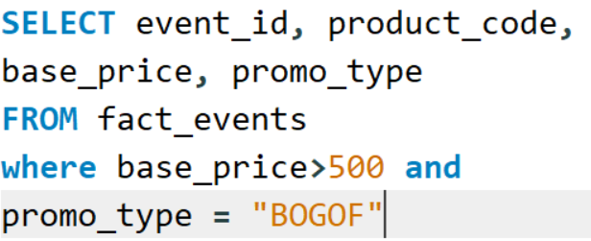
Request – 1
Provide a list of products with a base price greater than 500 and that are featured in promo type of “BOGOF”.
P14 – Atliq Waterproof Immersion Rod- Home Appliance
P08 – Atliq Double Bedsheet Set - Home Care

Slide 7
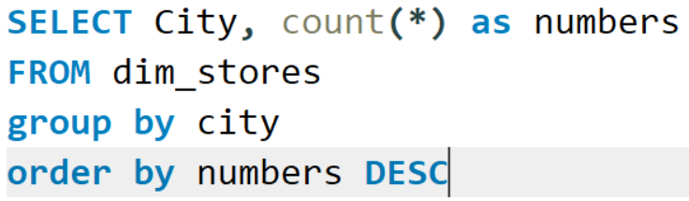
Request – 2
Generate report that provides an overview of the number of stores in each city.

Slide 8
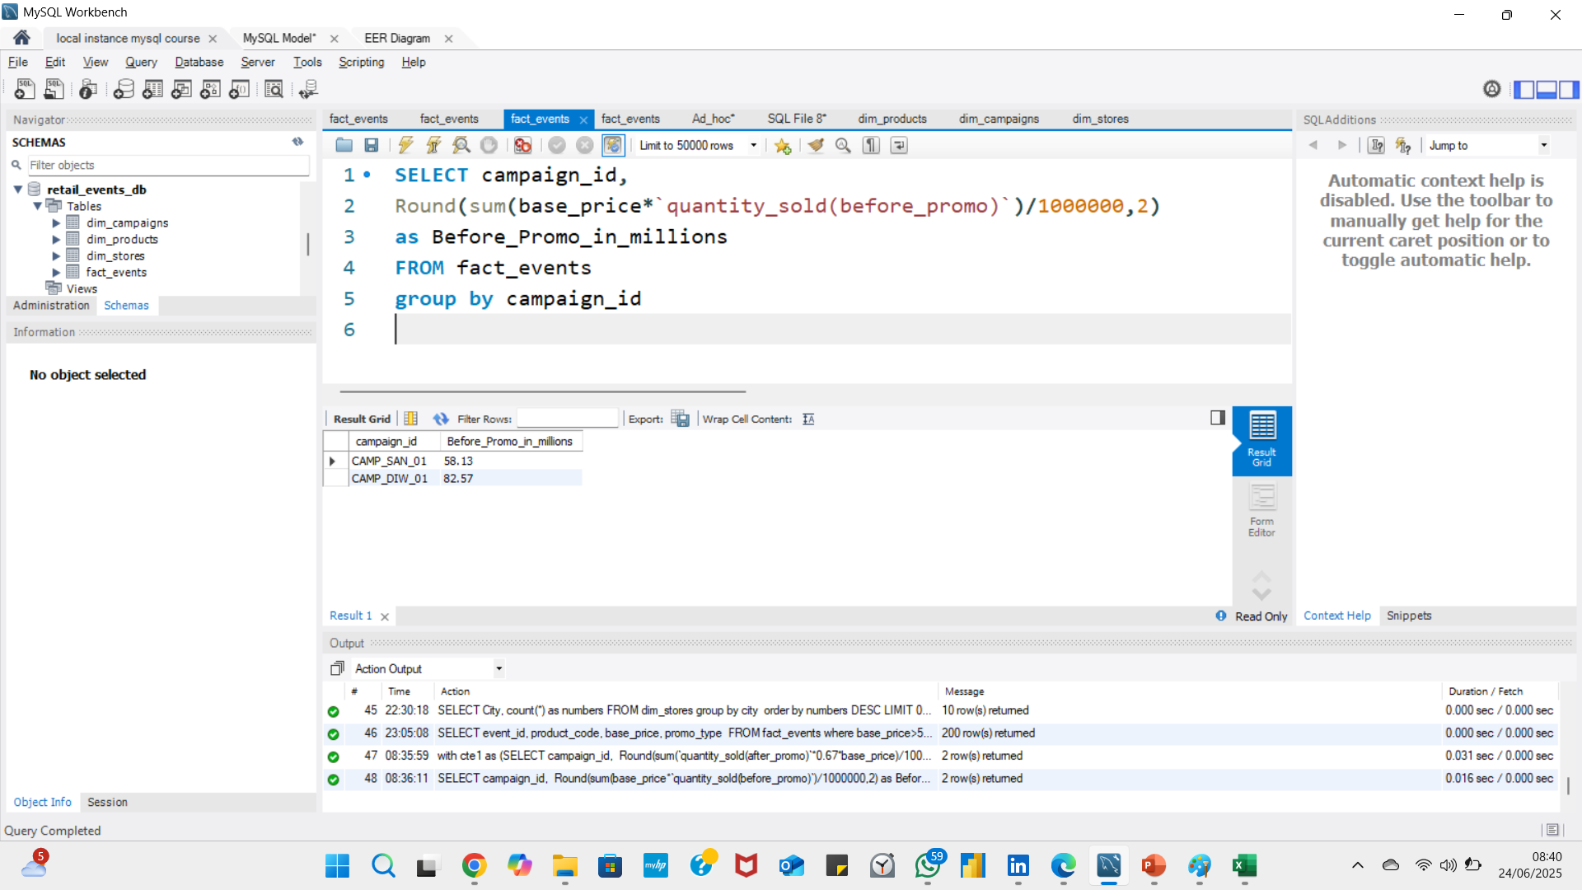
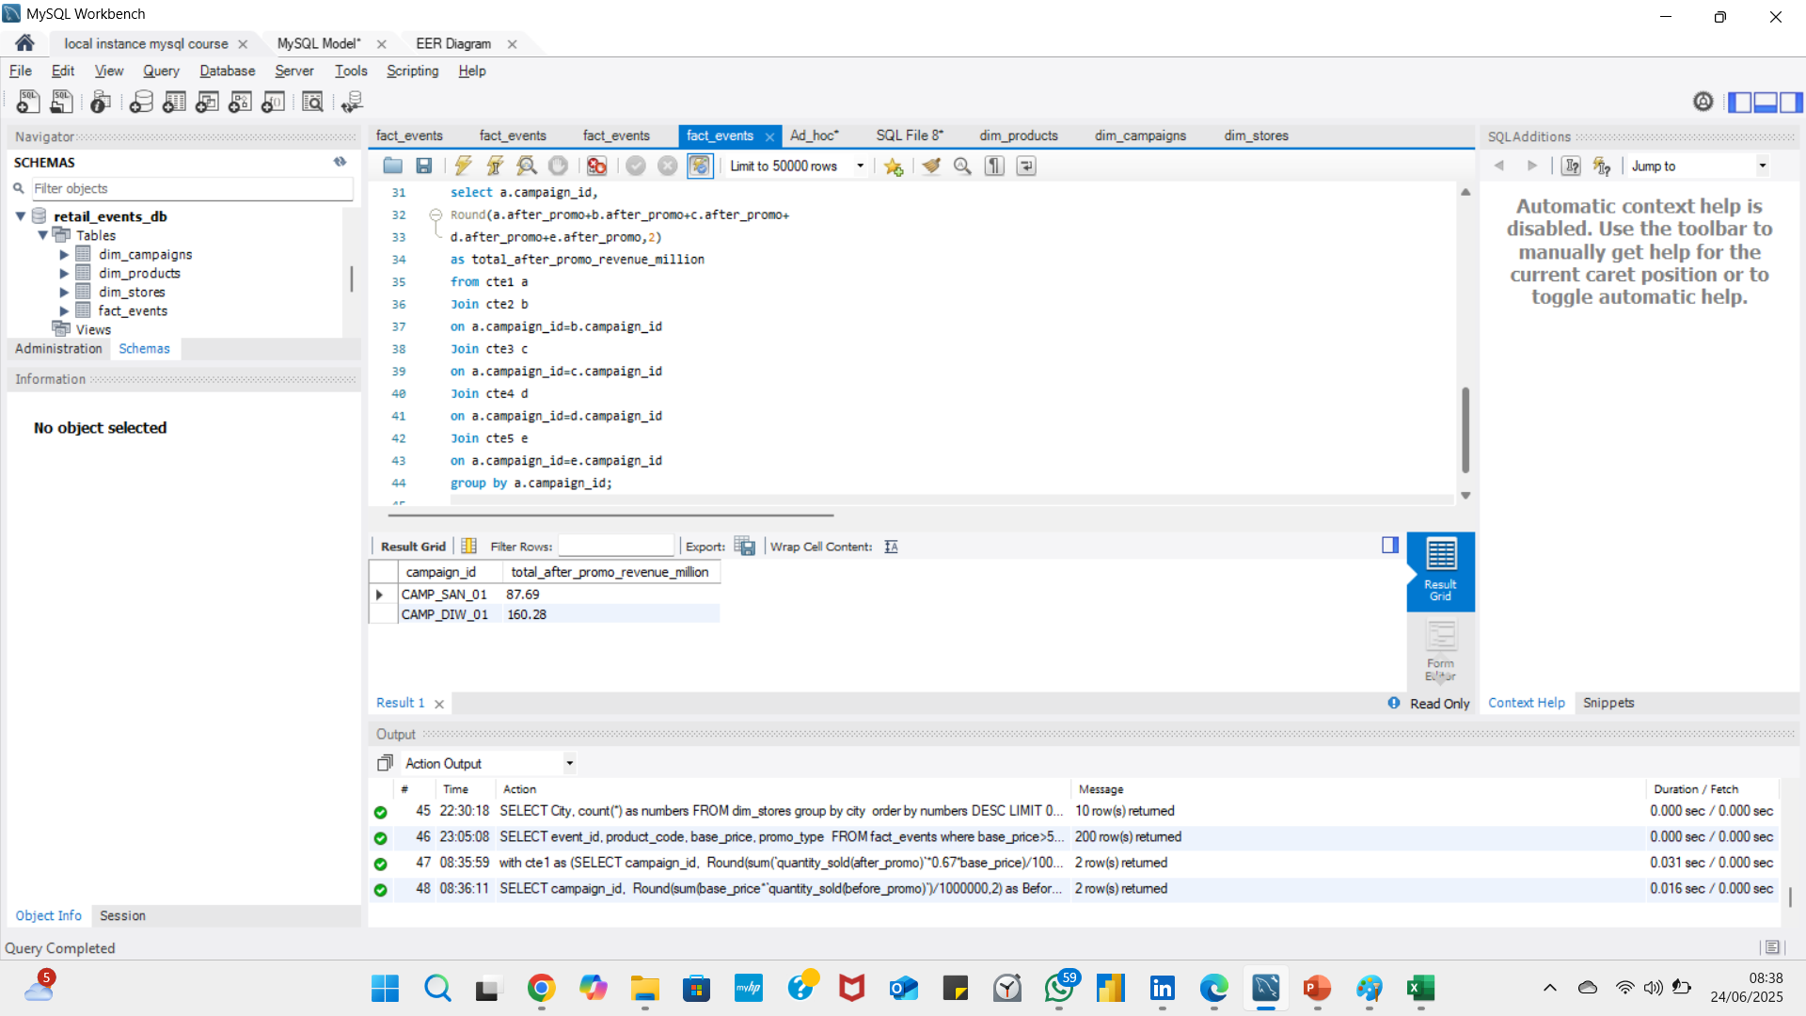
Before Promo
Request – 3
Generate report that displays the total revenue generated before and after the campaigns?
After Promo - Combination of CTE’s

Slide 9
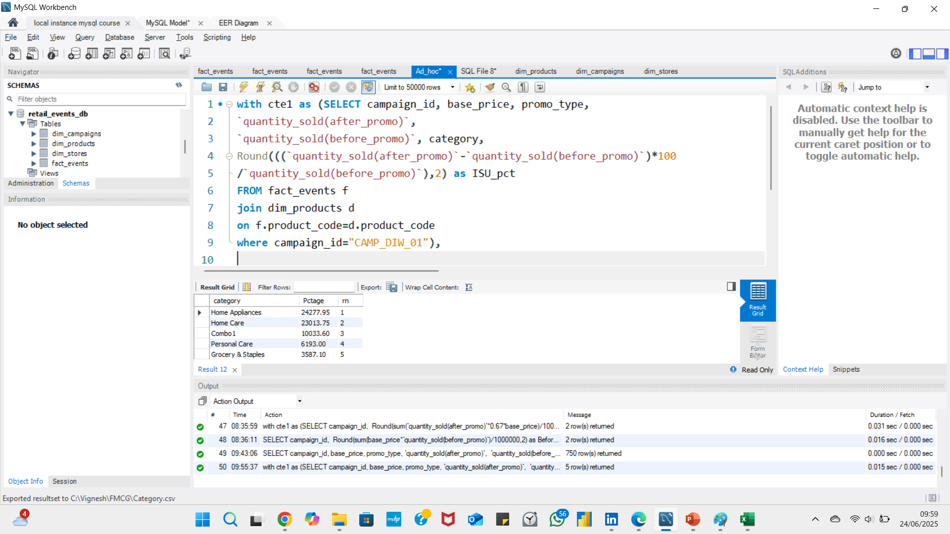
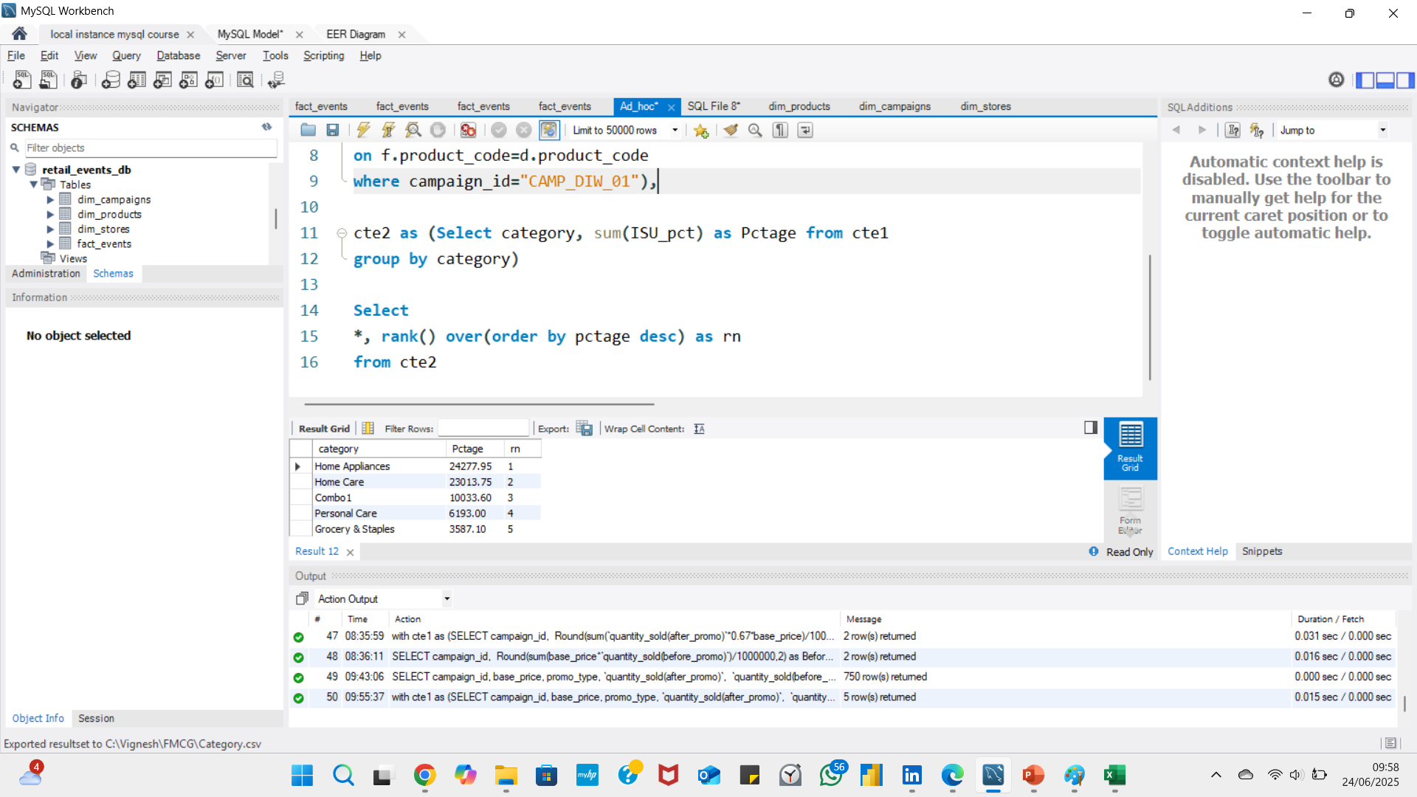
Request – 4
Ranks
Generate report that calculates the Incremental sold quantity (%) for each category during Diwali campaign and provide rankings based on their ISU%.

Slide 10
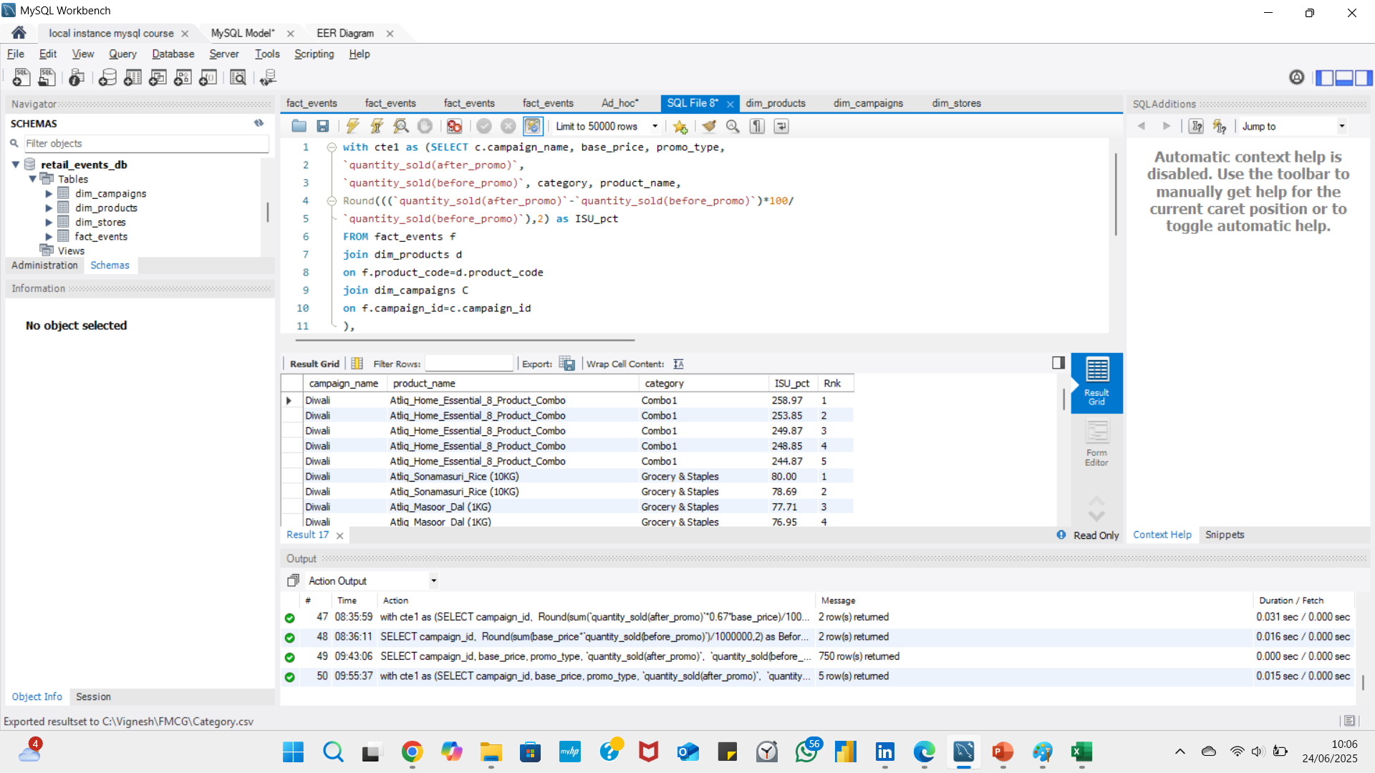
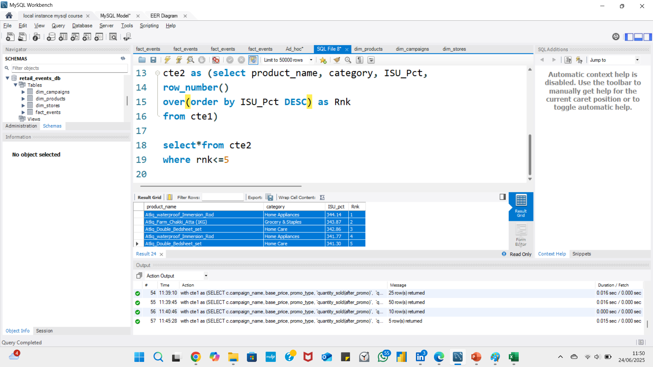
Request – 5
Generate top 5 products ranked by Incremental Revenue Percentage (IR%) across all campaigns and include essential information including product name, category and IR%.
Top 5

Slide 11
344%
Product Name | Category | ISU (%) | Rank
Atliq_waterproof_Immersion_Rod | Home Appliances | 344.14 | 1
Atliq_Farm_Chakki_Atta (1KG) | Grocery & Staples | 343.87 | 2
Atliq_Double_Bedsheet_set | Home Care | 342.86 | 3
Atliq_waterproof_Immersion_Rod | Home Appliances | 341.77 | 4
Atliq_Double_Bedsheet_set | Home Care | 341.3 | 5

Slide 12



Contact
vigneshwaran1597@gmail.com
https://codebasics.io/portfolio/Vigneshwaran-G
GITHUB

Slide 13
Thank you!

